Slide 1
HIV Epidemic in the United States
Lirong Peng
Visualization of Complex Data DATS_6401_011

Slide 2
Backgrounds
HIV is a significant and preventable public health problem world wide. As of 2017, approximately 36.9 million people were living with HIV, which is the 0.8% of population.
Due to the global efforts to address this challenge during the past two decades, the number of people newly diagnosed with HIV, and the number of AIDS-related deaths have declined over the years.
The reason of choosing the HIV datasets
To explore the details of the HIV epidemic in the United States and to show the main facts using interactive graphs

Slide 3
Sources of the datasets
Incidence, death rate, gender, race, and age information of HIV in US in 2017
https://gis.cdc.gov/grasp/nchhstpatlas
HIV incidence rate from 2008 to 2016
https://https://catalog.data.gov/dataset/hiv-incidence-rate-2009-2016
State distribution of HIV incidence in 2017 in US
https://opioid.amfar.org/indicator/PLHIV

Slide 4
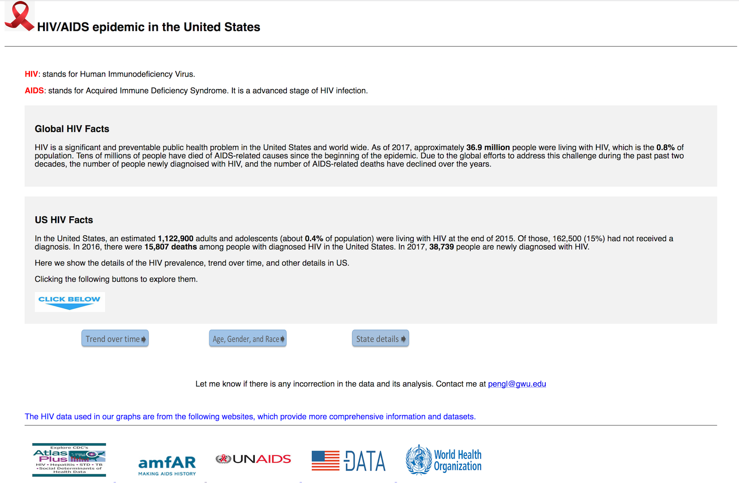
Design of the website

Slide 5
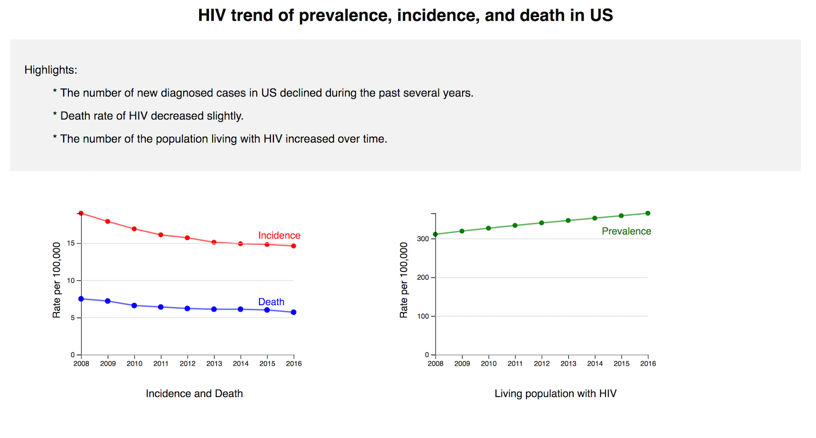
Using line graphs to show the trend of HIV prevalence, incidence, and death during the past eight years in US

Slide 6
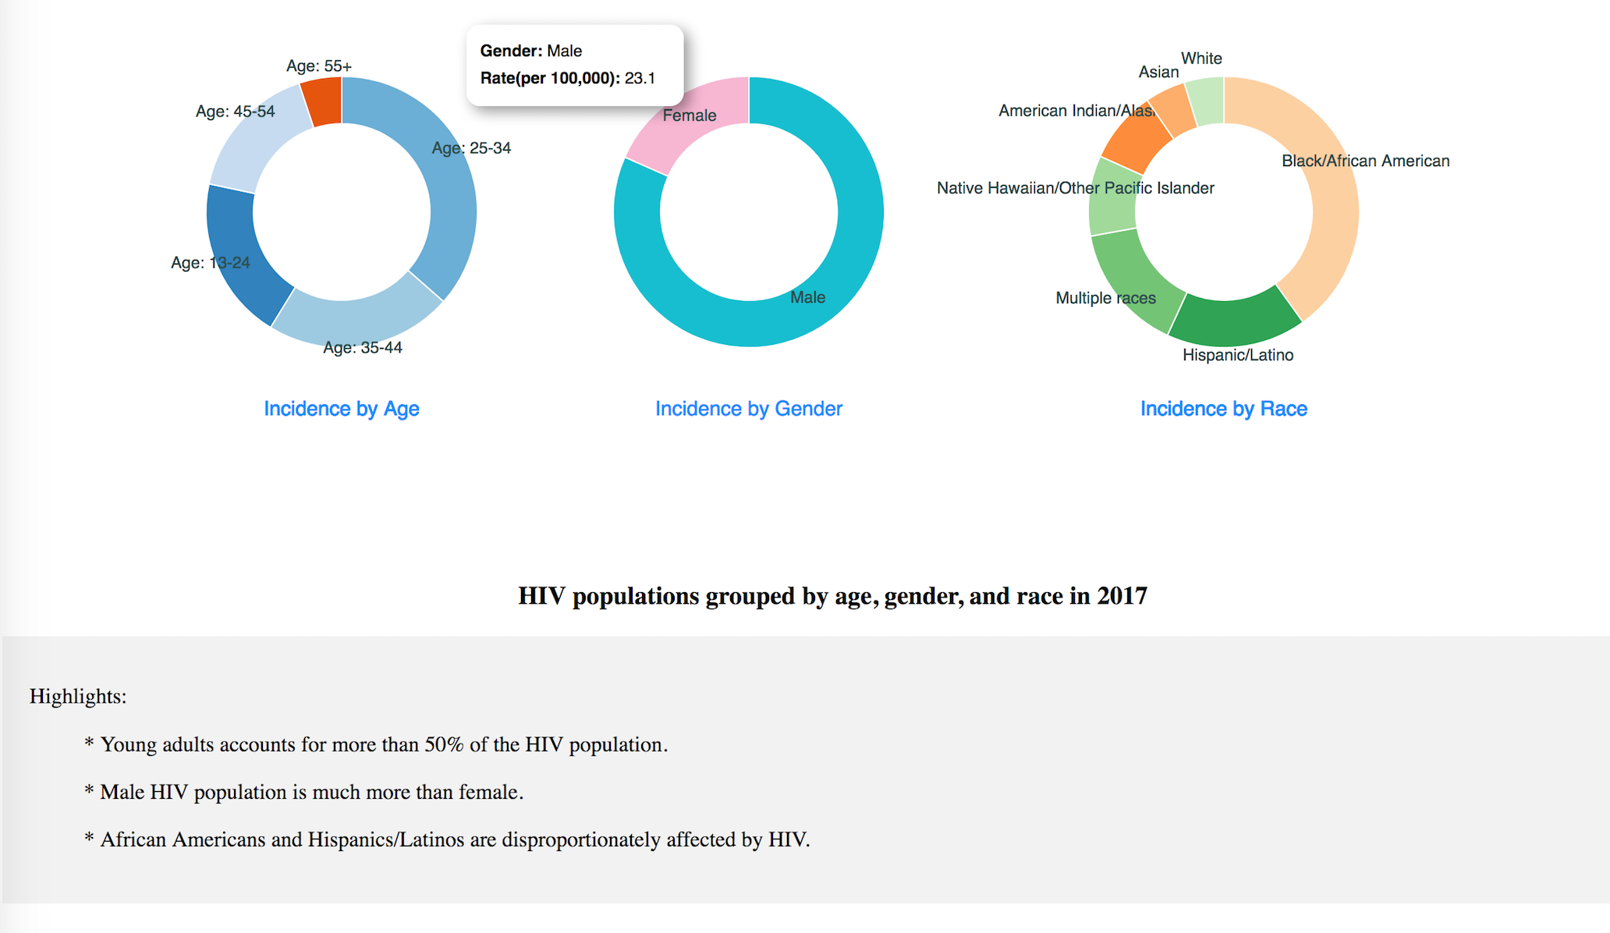
Using donut graphs to show the difference of HIV incidence among age, gender, and race groups in US

Slide 7
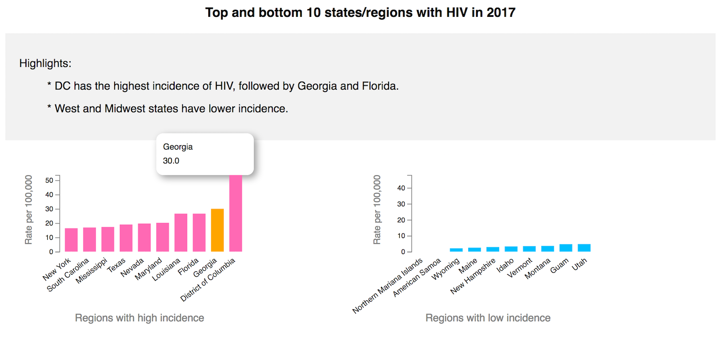
Using bar graphs to highlight the states or regions with the highest or lowest HIV incidence in US

